Slide 1
Towards Better Intervention:
Predicting At-risk Regions
Team X: Sarah May, Clara Sorensen, Hui Zhu
April 30, 2016

Slide 2
Current Challenge And Our Goal
Current Challenge: Channel limited resources to drive maximum impact in diabetes prevention with limited data
Our Goal: Predict diabetic rates by county as a basis for effective resource allocation

Slide 3
Our Approach
Time Series Analysis: Can historical diabetic rates predict future rates?
Correlation Analysis: Can livability index predict diabetic rates?
Focused on Alabama, the state with the highest variance in diabetes rates
Using data from 521 sub-regions in Alabama, determined correlation coefficients between each livability factor and 2012 diabetes rates
Clustered cities based on heavily correlated livability factors
Notes:
We took 2 different approaches: Clara: time series analysis on historical data
I wanted to look at livability factors and to try to determine what factors could be correlated to diabetes rates, and whether this data could be used to predict diabetes rates in other regions
I looked at livability indices from 521 counties in Alabama, as Alabama had the highest variability among its counties in diabetes rates for 2012

Slide 4
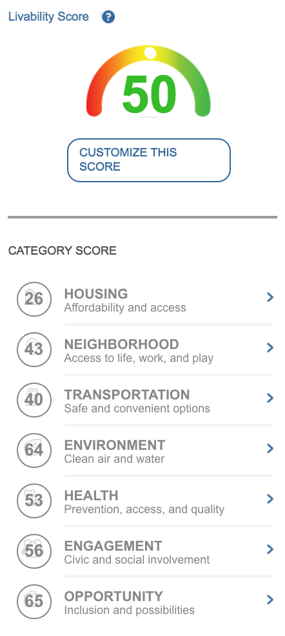
The Data
CDC County-Level Data:
total percent of population with diabetes from 2004-2012
AARP’s Livability Index:
scores calculated from over 40 metrics and 20 policies
communities are compared to one another (weighted values)
the lower the value, the less “livable”
Notes:
score of 50 is “average”
can’t extract the data from AARP easily

Slide 5
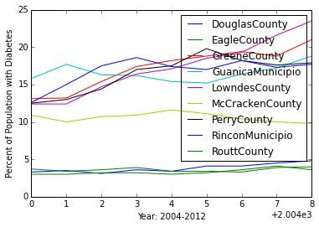
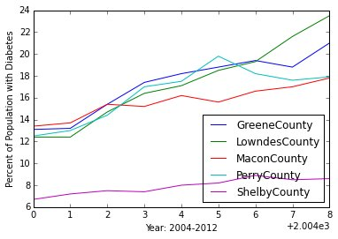
Time Series Analysis: Historical rates are good proxy for future rates
Selected United States Counties and Territories
Selected Alabama Counties
Notes:
1st graph: the counties that started with higher diabetic rates tended to have rates increase more dramatically over time as compared to those that started with relatively lower (the lowest rates from the data set in fact) diabetic rates
2nd graph: Shelby County consistently had the lowest diabetic rate in Alabama counties
Additionally, there is overlap in which counties were selected--why? we found that Alabama had the greatest variance
the data only went through 2012→ this inhibits policy makers from making relevant decisions if they want to use diabetic data for input

Slide 6
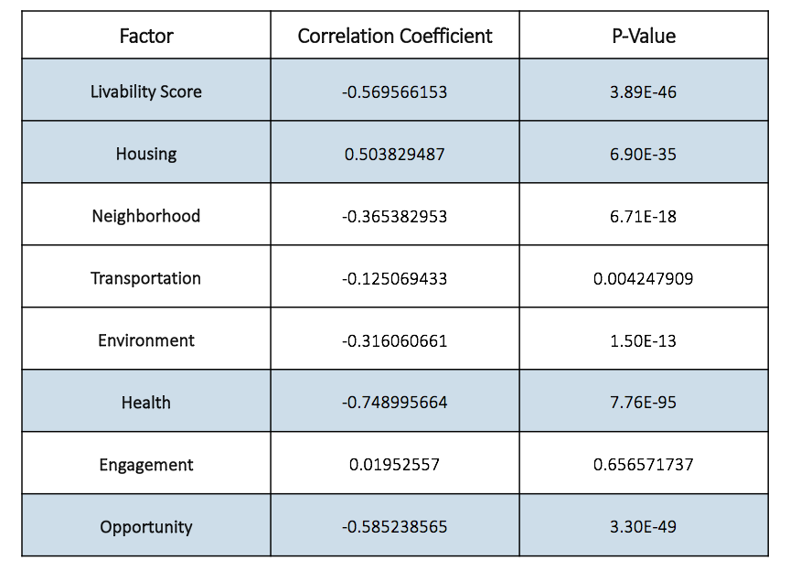
Correlation Analysis: Rates are strongly correlated with housing & opportunity metrics

Slide 7
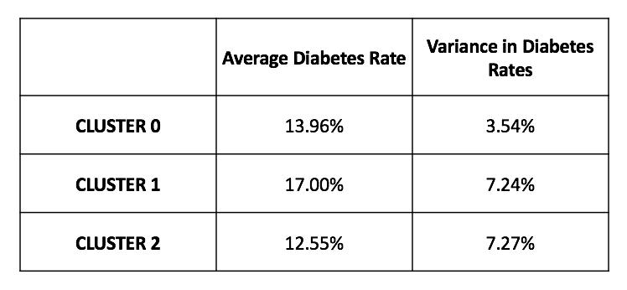
Clustering Analysis
Clusters not very informative
Size of data set
Breakdown correlated factors
Future work can be done to develop metrics that can predict diabetes rates in cities based on livability metrics

Slide 8
Next Steps
Zoom in on particular livability factors (e.g. the data that contributes to a housing score)
Extract livability data for more regions
Develop better livability metrics to cluster regions
Evaluate whether it is possible (using K-Nearest-Neighbors) to predict the level of diabetes risk (low, medium, high) in a particular region

Slide 9
Model Potential
Better Intervention: Evidence-based policy making and budgeting
Establish strong correlation between health outcome of county citizens and the social economic stability of the county
More investment on job opportunities and education will lead to disease prevention

